Slide 1

School readiness attendance and reimbursement training guide
Notes:
Le t’ s go over the Ru l e or (SR) 6M-4.500 Child Attendance and Provider Reimbursements.

Slide 2


SR Attendance
Detailed instructions at Frequently-Used Links:
https://providerservices.floridaearlylearning.com
Provider Portal User Guide
Pages 106-110
Notes:
If you need more information, there are detailed step-by-step instructions available in the Provider Portal User Guide pages 106-110.

Slide 3

6M-4.500 Child Attendance and Provider Reimbursements.
(a) A school readiness provider shall not receive payment for a student prior to the student’s first day of attendance or after the student is terminated from the school readiness program.
(b) Reimbursement rates shall be paid based on a child’s care level and unit of care as defined by the coalition’s approved provider rate schedule for the county in which the provider’s facility is located.
(c) Daily attendance documentation shall be maintained by each school readiness provider based on the terms of the Statewide School Readiness Provider Contract, specified in Rule 6M-4.610, Florida Administrative Code (F.A.C.). The provider must record daily child attendance using a paper sign-in and sign-out form or electronic attendance-tracking system that is maintained at the provider site to validate the attendance data.
(f) The provider must report any discrepancy, overpayment, or underpayment within sixty (60) calendar days of transmission of the reimbursement summary. Reported changes must include supporting documentation. Discrepancies validated by the coalition will be corrected for reimbursement purposes

Slide 4
SR Attendance
Requirements before submitting the attendance:
Active Provider Profile
Closures and Paid Holidays
Enrolled SR Children
Attendance sheets should be submitted in month order by the 3rd business day of each month. Any attendance received after the 3rd business day of the month, will be processed the following month.
Notes:
To submit SR Attendance, log into your Provider Portal account. You need to check that you’ve met these 3 requirements before submitting your first attendance.
Active Provider Profile
Closure and Paid Holidays
Enrolled SR Children

Slide 5
Provider Processing
Provider issues:
– Missing enrollments
– Duplicates with identical or overlapping schedules
– Too many open days
– Missing closed days (*)
– Missing paid holidays
– Missing wrap unit of care
– Missing summer/school unit of care changes

Slide 6
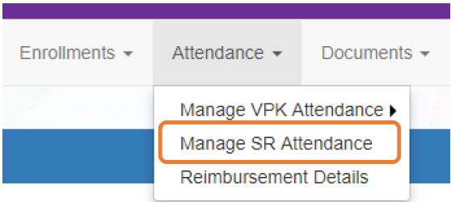


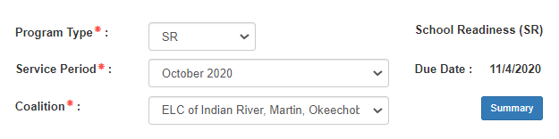
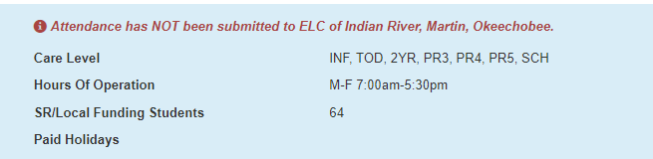

SR Attendance
Notes:
You’ll find SR Attendance in the Attendance tab, Manage SR Attendance. Select SR as the Program Type, then the service period, and the Coalition.

Slide 7
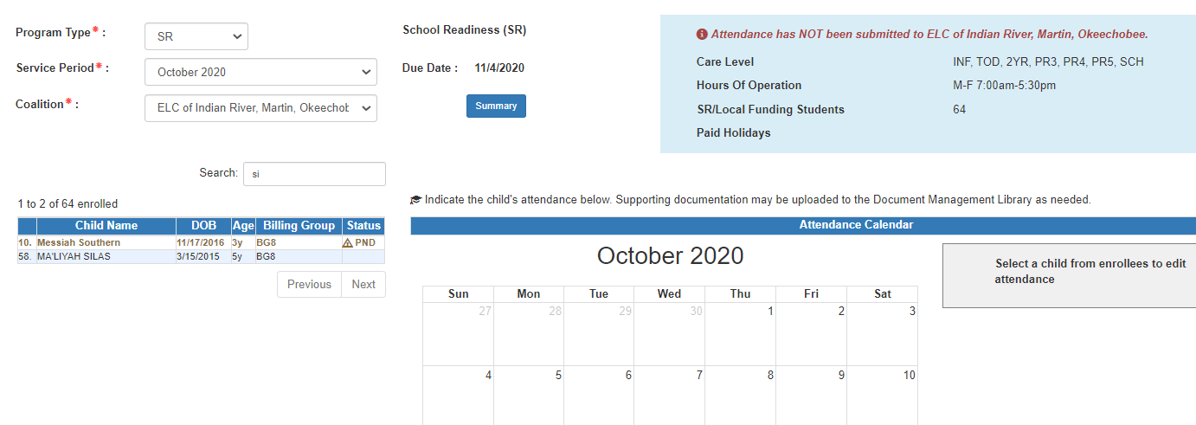
SR Attendance
Notes:
The SR Attendance Roster displays, defaulting to the current service period. The blue summary box to the right contains provider details and paid holiday information for the service period.
A service period is the month in which services were rendered. Child absences for the service period must be marked, saved, and submitted to the coalition. A due date is displayed for each service period. Providers that contract with multiple coalitions must submit an attendance roster to each coalition.
Children that are “Enrolled” or “Pending Parent Acceptance” are included on the SR attendance roster and their status will be displayed in the column marked in green. Children that are “Pending Parent Acceptance” are listed first and have an initial status of “PND”; children that are “Enrolled” do not have an initial status. When “PND” children are listed, a provider message will also appear. Clicking OK dismisses the message.
If a child is in “Pending Parent Acceptance” will be able to process attendance and be paid for these enrollments, but NOT until the payment certificate is signed by the family. you should encourage the parents to go to their parent portal to complete the signature for payment purpose.
The search feature, shown in yellow, may be used to search for any criteria included in the roster (such as a name, DOB, age, billing group, or status). The summary feature shows the current/saved attendance information for all children in one view.

Slide 8
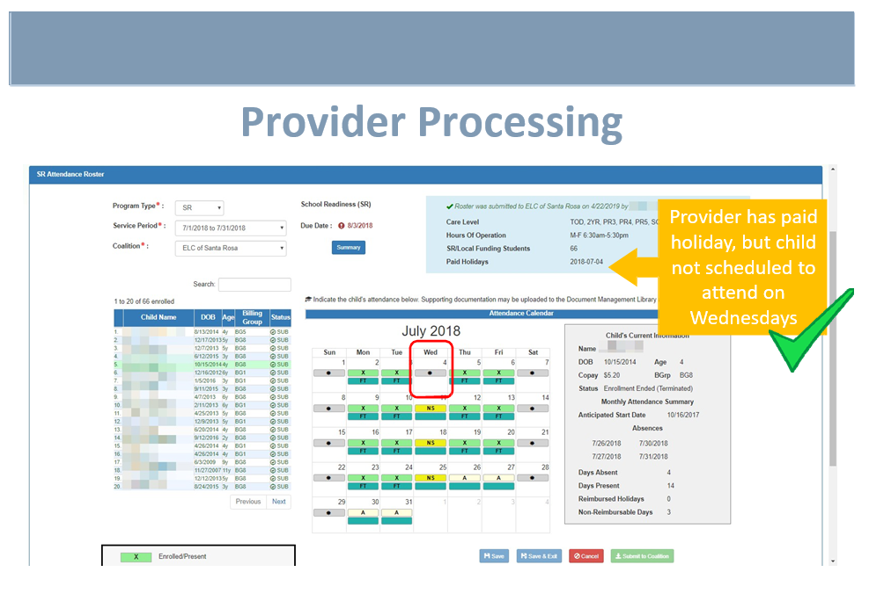
SR Attendance
Notes:
J

Slide 9
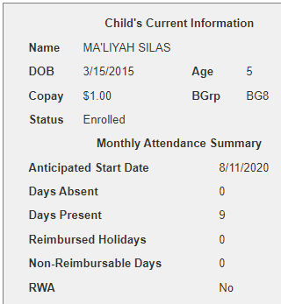
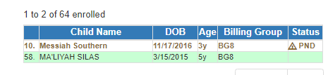
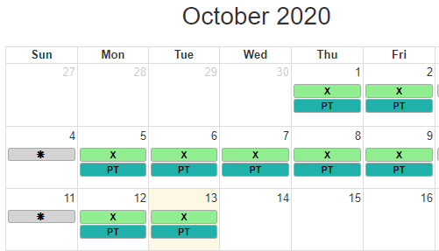

SR Attendance
Select a child and their schedule shows on the calendar
Notes:
To record attendance, click on a child’s name to view their attendance for the month. You will see a summary of that child in the grey box shown on the right.
The calendar displays each child’s schedule. You will not be able to mark attendance before their start date or after they’ve terminated care.

Slide 10
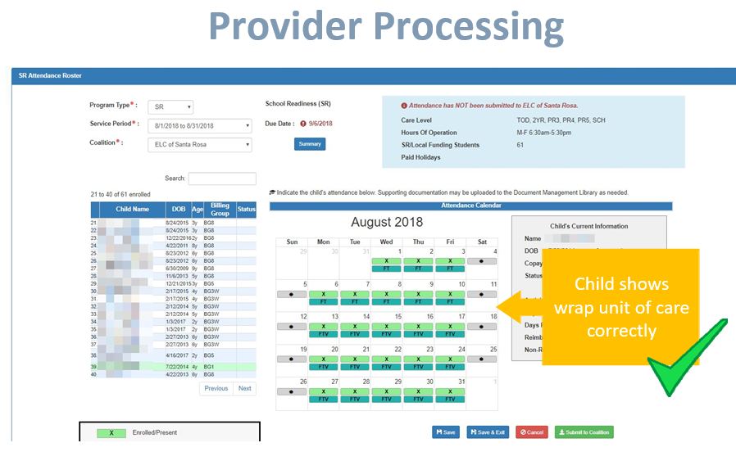
Wrap Unit of Care FTV/PTV

Slide 11
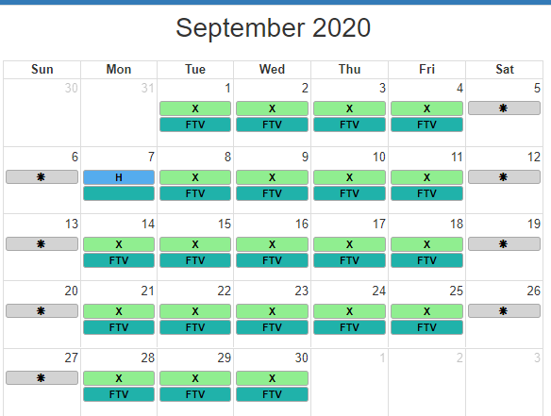
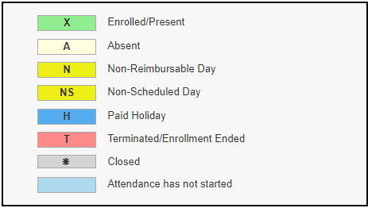
SR Attendance
Notes:
A code descriptions legend for marking attendance is provided in the bottom right of the sheet as shown on this slide.
Days the site is closed are marked with an asterisk “*.” (Grey)
Days the child is not scheduled to attend are marked with “NS.” “ N”(Yellow)
Days the child is scheduled to attend are marked with an “X” for present along with his/her scheduled unit of care.
Paid holidays where a child is also scheduled to attend are marked with an “H.” (Bright Blue)
While not required, it is recommended to click Save (below the calendar) before moving on to another child.

Slide 12
Consecutive absences Extraordinary circumstances does not include vacation or recreational time.
To change a present day to absent, click on the “X.” A pop-up message appears to collect more information.
Include a message to the coalition regarding the absence in the Note area. (optional for most reasons)
c. Attach a file for supporting documentation by clicking Choose File. (optional)
d. Click Save when done and the pop-up message will close.
e. The “X” for present will now appear as an “A” for absent.
Consecutive absences can be entered by using a date range. A document can be attached to the absence range and the document will be associated to every day entered in the date span.
g. Absences entered by mistake can be changed back to present by clicking on the “A.” The below pop-up message appears. To undo the absence, click the Remove Absence button. That day will show an “X”, the absence reason is removed, and the attachment is removed.

Slide 13
Absences per calendar month
Reimbursement shall be authorized for no more than three (3) absences per calendar month per child except in the event of extraordinary circumstances in which case the coalition or its designee shall document approval for payment based on written documentation provided by the parent justifying the excessive
absence for an additional ten (10) days. Extraordinary circumstances does not include vacation or recreational time.
Examples of extraordinary circumstances include but are not limited to the following:
1. Hospitalization of the child or parent with appropriate documentation (i.e., doctor’s note, hospital admission),
2. Illness requiring home-stay as documented (i.e., doctor’s note, parent statement),
3. Death in the immediate family with appropriate documentation (i.e., obituary, death certificate, parent statement),
4. Court ordered visitation with appropriate documentation (i.e., court order),
5. Unforeseen documented military deployment or exercise of the parent(s) (i.e., military orders of deployment, reserve duty),
6. Doctor appointments or other health related appointments (i.e., therapy, routine).
(b) Total monthly reimbursed absences shall not exceed thirteen (13) calendar days.
Notes:
Extraordinary circumstances does not include vacation or recreational time.
Provider is responsible to override the days “N’ non-reimbursable days.

Slide 14
Notes:
Reporting BG1-At Risk Designated Child Absences
The School Readiness Provider must adhere to Rilya Wilson “mandatory absence
reporting” requirement.

Slide 15
Reporting BG1-At Risk Designated Child Absences
An at-risk child as defined in Section 1002.81(1), F.S.,
may not be disenrolled from the program without the written approval of the Child Welfare Program Office of the Department of Children and Families or the community-based lead agency. A notice of termination shall be maintained in the case file and provided to the parent, provider and referring agency.
(e) When an at-risk child under the age of school entry has one (1) unexcused
absence or seven (7) consecutive days of excused absences, the school
readiness provider shall notify the Department of Children and Families or
community-based lead agency and the early learning coalition prior to the close of business on the day of the absence.
The provider shall maintain documentation of the notification. The coalition shall document any contact made with the provider, referring agency and parent in the case file.
Notes:
The School Readiness Provider must adhere to Rilya Wilson “mandatory absence
reporting” requirement. When an at-risk child has an unexcused absence or seven consecutive days of excused absences, the school readiness provider shall notify the Department of Children and Families or community-based lead agency and the early learning coalition. The coalition shall document any contact made with the provider, referring agency and parent in the case file. This paragraph shall apply to all at-risk children under the age of school entry. This rule shall apply to all at-risk (BG1) children of any age in a school readiness program (6M-4.500, F.A.C).

Slide 20
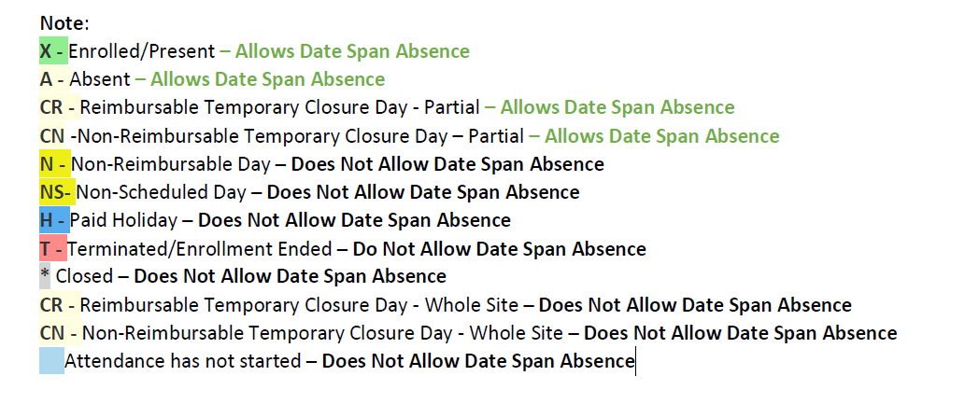

Slide 21
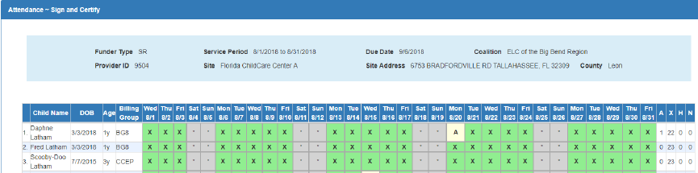
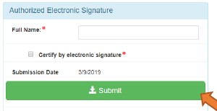
SR Attendance
Review of all attendance before final Sign and Certify
Notes:
When all child absences are marked for the month, click Save and then click the Submit to Coalition button. A window may appear if the attendance is being submitted early or late, or if no absences have been recorded. To continue to the Sign & Certify page, click Continue.

Slide 22
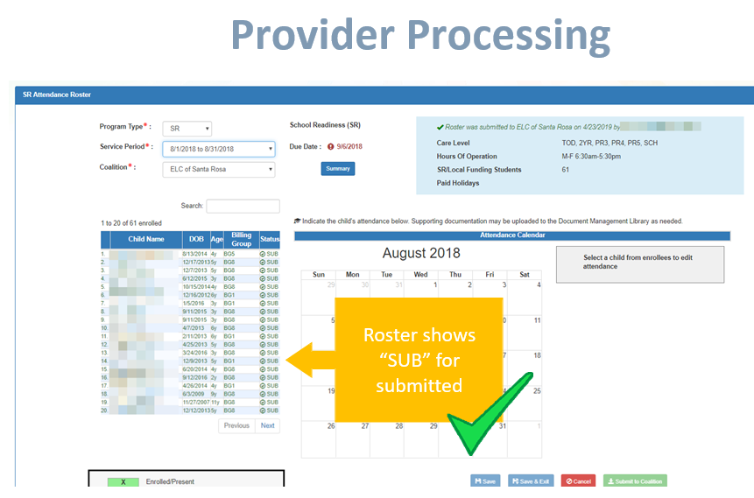
Attendance Submitted

Slide 23
Rejected Attendance
Coalition staff may reject submitted attendance. In this case, the individual that submitted the roster will receive
an email notification. Instructions are provided to log in to the Provider Services Portal, review the roster, make
necessary changes to records and re-submit. The rejected child records are displayed at the top of the roster list in red and show "REJ" for rejected in the status column. Only records with "REJ" may be edited.
rejected

Slide 24
SR Attendance Issues that should be Address prior to submitting the Roster:
Contact ELCIRMO when:
Paid holidays are missing from the attendance calendar,
Information on the roster is incorrect (such as child’s date of birth, billing group, unit of care, scheduled days, termination date, etc.),
Enrolled children are missing on the roster,
Children appear on the roster more than once, or
Absences get saved multiple times on the same day.
Notes:
There are times when you’ll need to ELCIRMO. These include when:
Paid holidays are missing from the attendance calendar,
Information on the roster is incorrect (such as child’s date of birth, billing group, unit of care, scheduled days, termination date, etc.),
Enrolled children are missing on the roster,
Children appear on the roster more than once, or
Absences get saved multiple times on the same day.
These issues should be addressed prior to submitting the roster as they will impact processing for reimbursement.

Slide 25
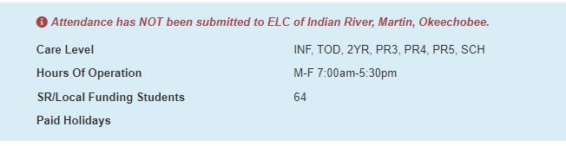
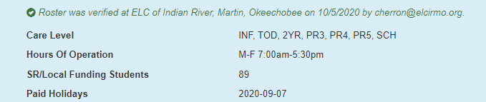
SR Attendance
Not Submitted
Submitted
Notes:
Upon submission, the screen returns to the SR Attendance Roster view with the current service period displayed. Select the submitted service period from the drop down. The submitted roster now has a submitted message and each child shows “SUB” for submitted in the status column. This status will change as the child attendance is processed by the coalition.

Slide 26
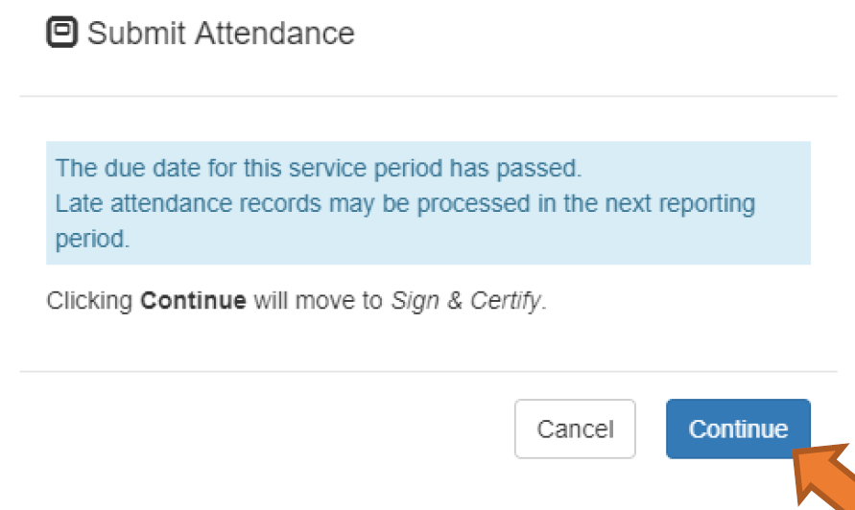
SR Attendance

Slide 27

SR Attendance
If you need assistance, please e-mail or
772-220-1220.
If you need to leave a message
Notes:
You’ll get a faster response using the data issues upload process outlined in the instructions for handling SR attendance issues, however, if you need to call or e-mail Please leave only one message and allow for 1-2 business days for a return call. We are minimizing the number of staff answering phones so that they may focus on the correction of data issues and the processing of attendance. Our goal to make needed corrections for everyone so that we can move forward with SR reimbursement.

Slide 28
Sign-In/Sign Out Sheets
Sign in/out sheets must include:
Name of child (must match name on the ELC Enrollment Certificate)
Complete Date
Time in-out (must be accurate to the minute, may not be rounded up or down)
Full signature of person signing child in (in ink)
Full signature of parent or person authorized by the parent to pick up child (in ink)
Name of Facility/Provider (must match name on Enrollment / Attendance Certification)
Month / Year
Siblings must have individual sign in/out sheets • Signature Guidelines: Clear Full Signature (First and Last Name) required, of the parent or person authorized by the parent to drop off/pick up the child. Signature should be legible or match the parent’s/authorized guardian’s government
Notes:
Parents receiving subsidy funding must sign the child in and out each day in order for payment to be authorized. If false information is knowingly provided, the parent may be liable for prosecution under state law, and childcare services will be terminated. If false or inaccurate attendance information is given, that information will be reported to the Florida Department of Law Enforcement for action.

Slide 29
Data Red Flags discrepancy that will require additional training and technical assistances.
Child marked present on the attendance, but not signed in or out on the sign-in sheet.
child marked present, but sign-in and sign-out signatures are crossed out.
Claiming “X” when child was not in attendance
- Claiming “X” before the service begin date
- Claiming “X” after the service end date
- Claiming more than 3 Excused Absences (“E”)

Slide 30

FRAUD

Slide 31
Notes:
The provider must report any discrepancy, overpayment, or underpayment within sixty (60) calendar days of transmission of the reimbursement summary. Reported changes must include supporting documentation. Discrepancies validated by the coalition will be corrected for reimbursement purposes.

Slide 32
Fraud
Fraud” is an intentional deception, omission, or misrepresentation made by a person with knowledge that the deception, omission, or misrepresentation may result in unauthorized benefit to that person or another person, or any aiding and abetting of the commission of such an act. The term includes any act that constitutes fraud under applicable federal or state law.
In accordance with Florida Statutes 1002.91 and Florida Administrative Code (FAC) Rule 6M-9.400 Each early learning coalition shall adopt an anti-fraud plan addressing the detection and prevention of overpayments, abuse, and fraud relating to the provision of and payment for School Readiness program and Voluntary Prekindergarten Education Program services.

Slide 33
Post Audit
VPK Providers acknowledge that the Coalition, the Office of Early Learning, and other local, state and federal officials have the right to examine any documents and records that contain information about the VPK program.
All Documentation must be legible.
White-out must NOT be used anywhere on the forms. If an error is made, Providers must mark through the error and write-in the correct entry and initial.
The provider’s noncompliance with any terms of the Statewide Provider Agreement (Form OEL-VPK 20) may result in financial penalties
VPK child enrollment records are confidential and must be kept by the provider for at least three (5) years after the child’s last day of attendance.

Slide 34
Common types of fraud
Child Care Providers:
Asking a parent to sign a child in/out when they have not attended
Signing a child in when the child is absent to be paid for that day
Giving false information to the Coalition to receive payment for VPK
Giving false information to become or remain contracted for VPK

Slide 35

SR Attendance Data Issues/Error Messages
Please email Johanna Cruz(jcruz@elcirmo.org) of the issues you are having. Send screen prints/error message that you are getting, etc.
The more information you can provide, the more we can determine if we can help or if a ticket is needed.
Please be patient as we work together to figure out the best way to help you.
Notes:
If you are still experiencing data issues with VPK or SR attendance, please be sure they have been reported and then be patient while they are being fixed.

Slide 36

Questions?

